Slide 1
Classifying Vegetative and Urban Land Cover using Machine Learning
Lucas Lau

Slide 2
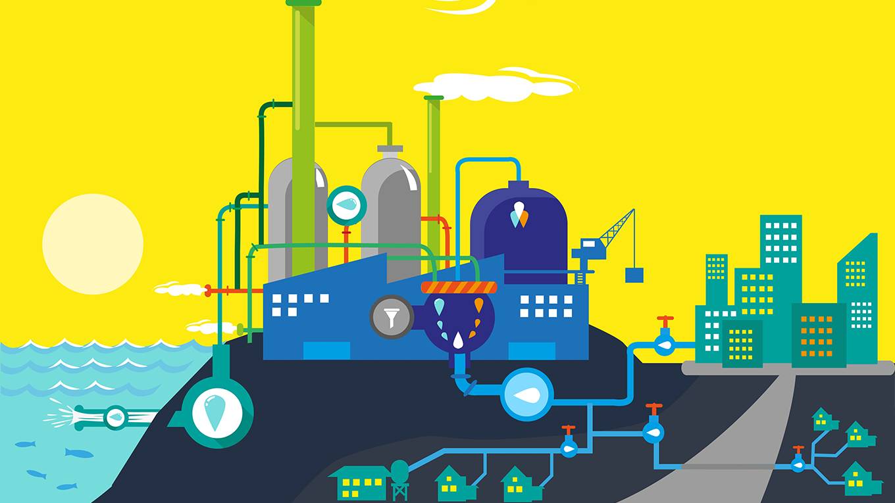
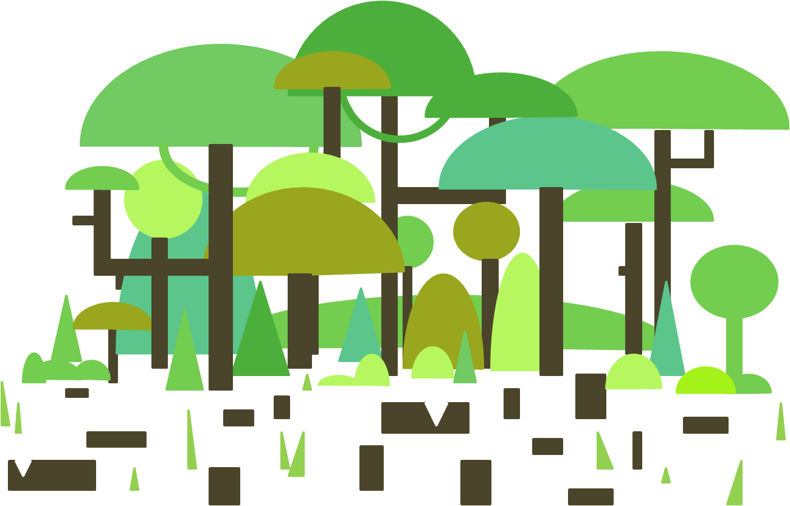
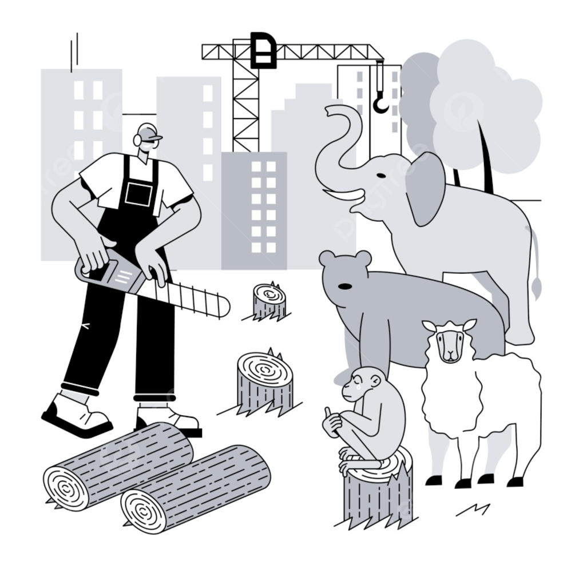
Introduction

Slide 3
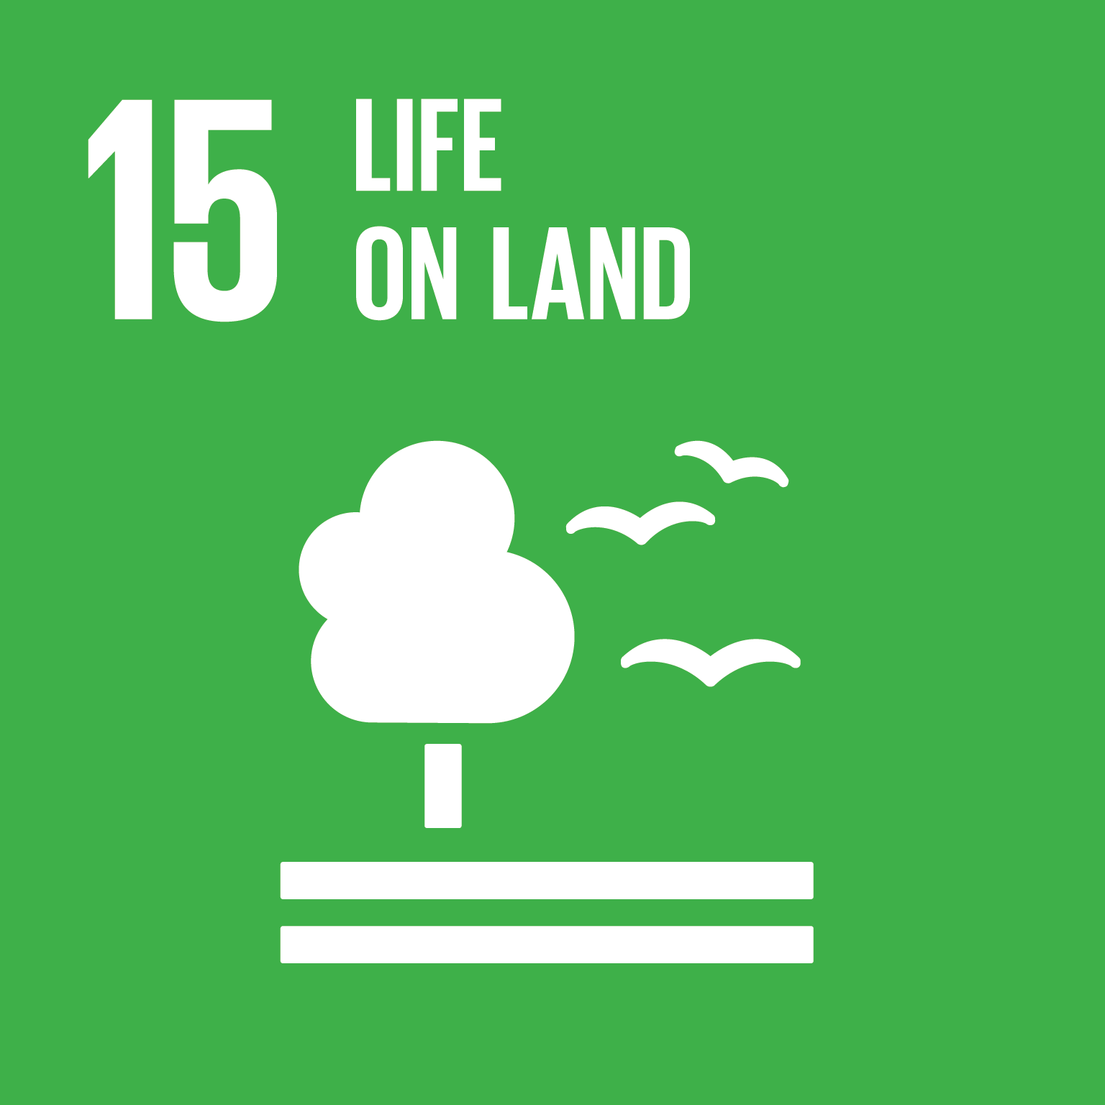



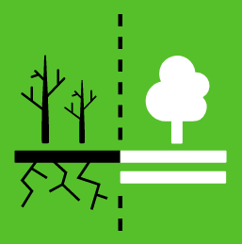
Introduction
How much land vegetation is lost through urbanization
Predict how much more vegetation will be lost
Propose possible land use planning to maintain sustainability

Slide 4

Random Forest?
Support Vector Machines?
Random Forest
Support Vector Machines
Artificial Neural Networks?
Decision Trees?
Iterative Selforganizing Data Analysis Techniques?
K-means?

Slide 5
Methodology
Division No. 18, Saskatchewan, Canada
Use NASA public domain for satellite images
10 Meter Resolution
R, G, B, NIR, NDVI
2010 to 2020, 2 year intervals
eCognition Image Segmentation
Random Forest + SVM Ensemble Model
Calculate Areas of Predicted Vegetation

Slide 6

Expected Outcomes
Successfully be able to differentiate between the different land covers (i.e. vegetation, dirt, and residential/urban land covers)
Determine the percentage increase or decrease of each land cover over the chosen 10 year period from 2010 - 2020
Expected that there will be an increase in residential/urban land covers and a decrease in forest and vegetation over the time period of 2010 - 2020

Slide 7
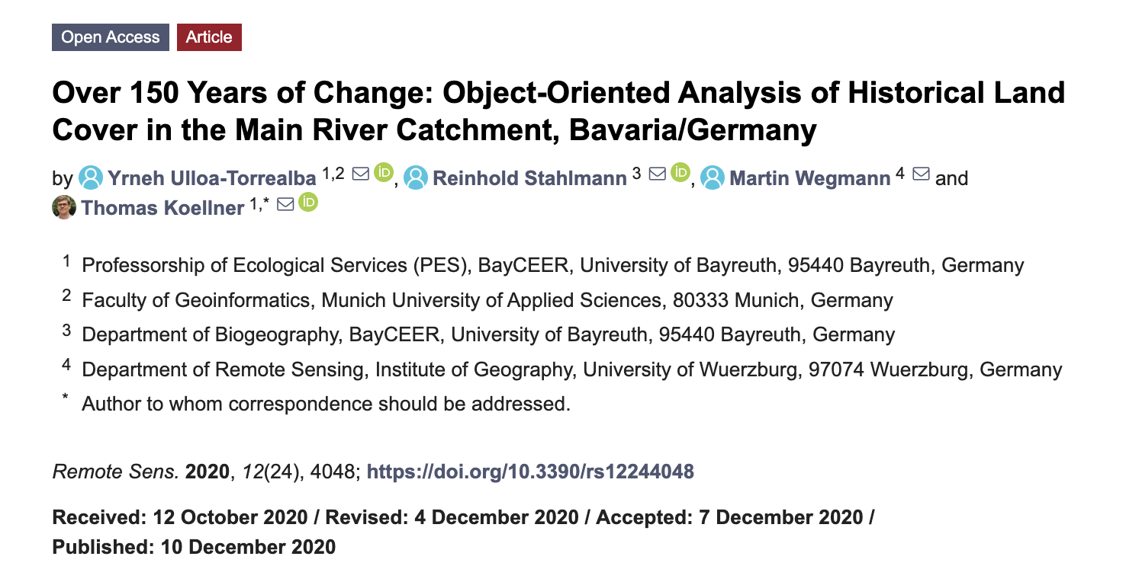
Related Article
Used eCognition to apply an object-based classification in order to analyze land cover based on historical maps over 150 years of change
Accounted for six (6) land cover classifications: cropland, meadow, forest, urban, letters & lines, and non-urban.
Strong increase in urban area from 0.3% to 8.8%

Slide 8
Important factors to consider…
Change percentage of each land cover classification can be influenced based on various factors such as:
Satellite image quality
Misclassification of objects
Not including enough land covers in the classification to effectively determine the loss of vegetation due to urbanization.

Slide 9
Thank you for listening~

